Slide 1
Data Governance
Presented By
Shamimatul Jannat

Slide 2
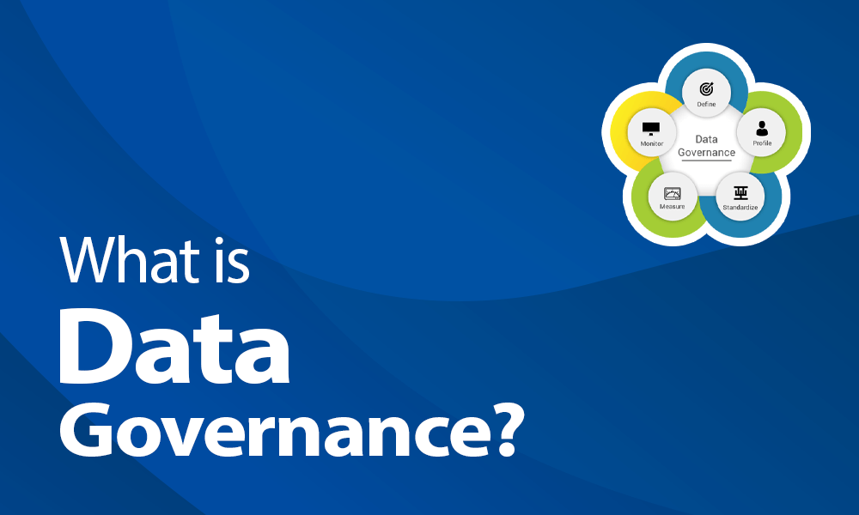

Slide 3
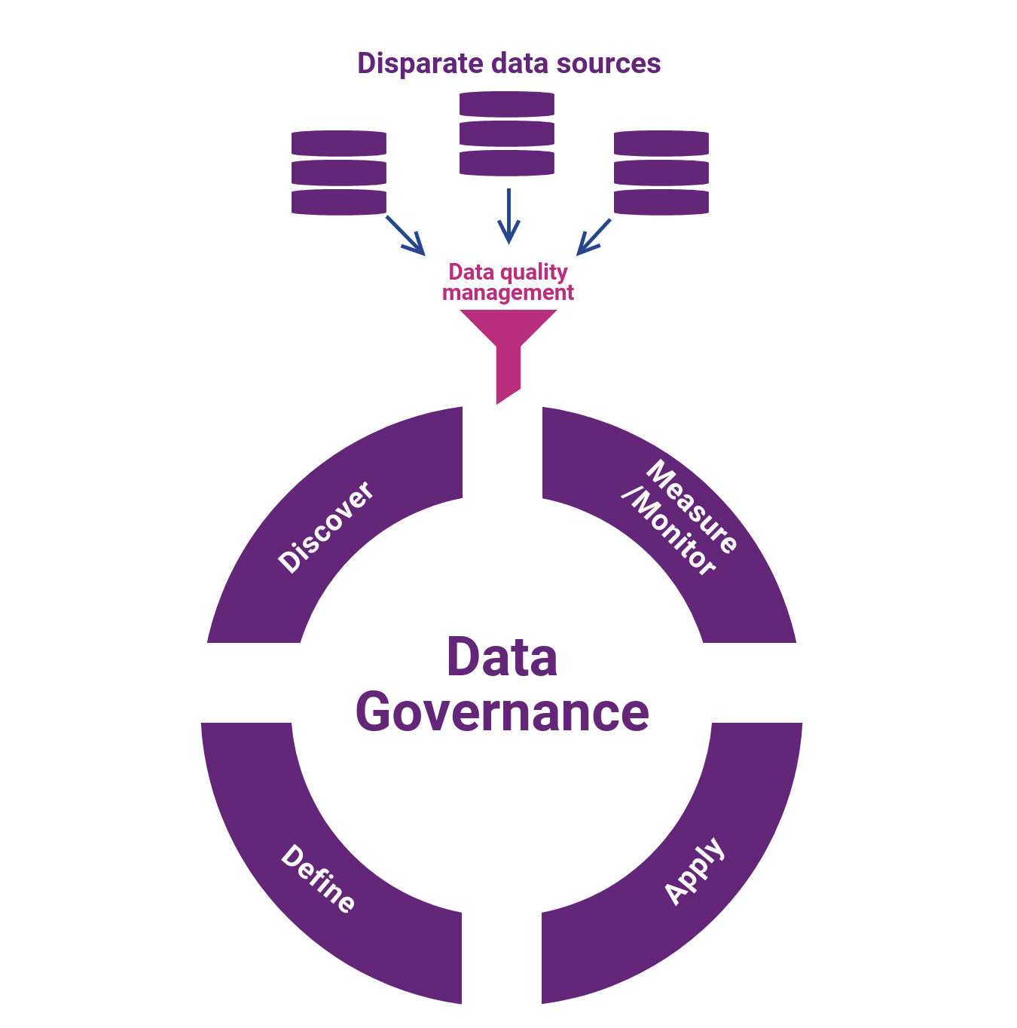
Data Governance
It is the process of managing the,
Availability
Usability
Integrity
Security
Of the data in enterprise system which is based on,
Internal data standards
Policies
Which control data usage.

Slide 4

Why data governance is Important?

Slide 5
Why data governance matters?
Organization’s needs to make sure of the,
Data security
Effective data masking of data quality
Compliance with new data protection
Privacy laws (GDPR - General data policy regulations)
An effective governance helps to handle all this kind of problems and ensures that data is,
Consistent
Trustworthy
And make sure that data doesn't get misused.

Slide 6
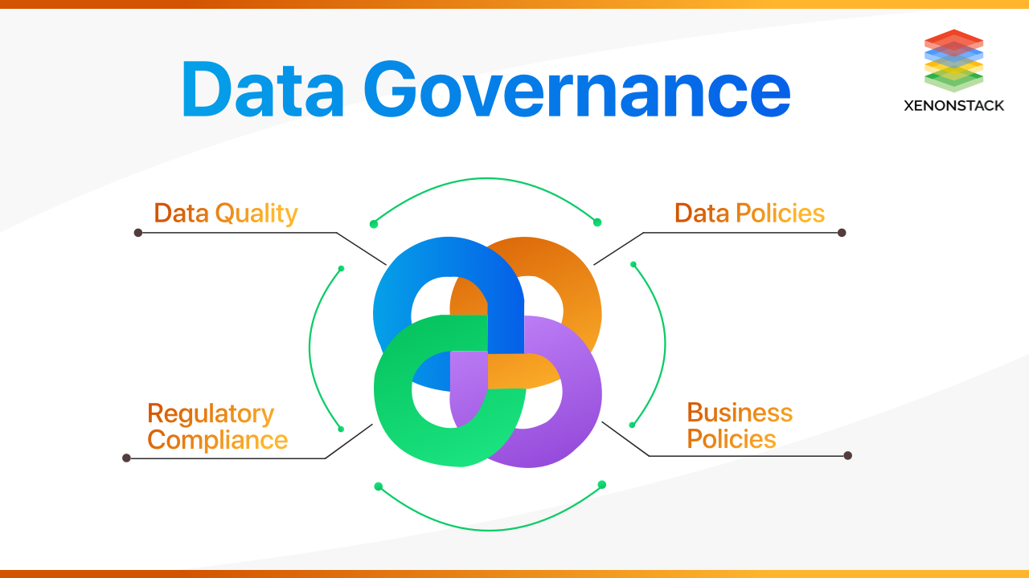
Benefits of data governance adoption

Slide 7
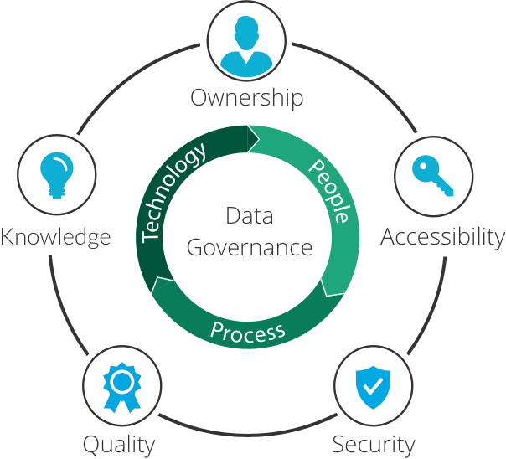
Benefits of data governance adoption
Benefits of data governance are shortly discussed,
To improve quality of insights
It helps in understanding the data and shows the data lineage
Helps in adopting Regulatory Compliance
Improve the capabilities of Decision-Making and communication
Reduction of IT costs with centralized policies and systems
Effortless audit management
Controlled and organized data growth

Slide 8
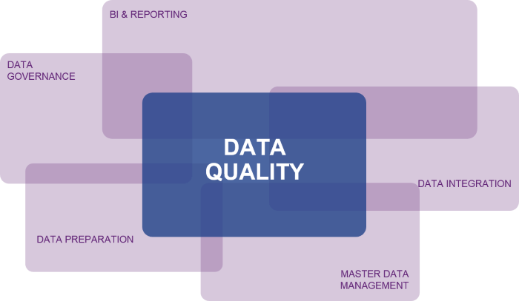
Data Quality
Data quality is focused on the
Integrity
value of the information itself

Slide 9

Data Policies
A data governance policy is
A documented set of guidelines
For ensuring that an organization's data and information assets are managed consistently and used properly.

Slide 10
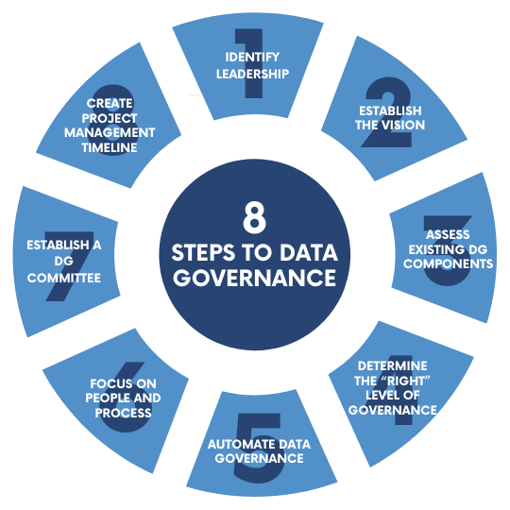
Adapting the data

Slide 11
How to adopt data governance?
Find where the improvement is needed in the system
Choose a small portion of data to apply, then apply on all
Define roles, responsibilities, and processes for different teams
Understanding data
Cleaning the data
Data transformation or enrichment
Monitoring
Integrity of data
Organization must change the culture of the organization to be master data-based rather than transaction data-based

Slide 12
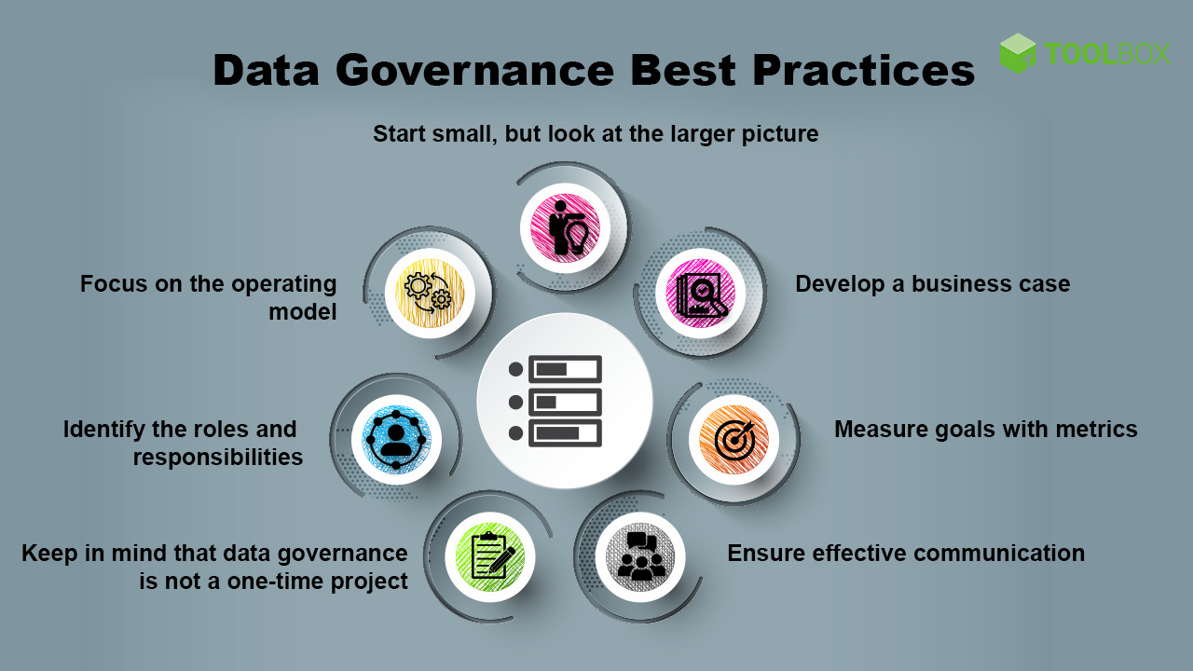
Good practices of data governance

Slide 13
Good practices of data governance
Target big start with small
To choose data stewardship wisely
Data governance and quality are integrated
Data quality and reliability checks
Test your governance for big data

Slide 14

Data Governance Tools

Slide 15
Tools for data governance
Apache Atlas
SAP Master Data Governance
Alation Data Catalog
Informatica
IBM Watson
Collibra

Slide 16
Apache Atlas
Apache Atlas is the governance and metadata framework for Hadoop. It supports several Hadoop components to manage metadata in a central repository. The metadata events are captured and stored in the metadata store then these metadata events can be classified using tags. These tags can be further used to enforce security policies by Apache Ranger

Slide 17
Alation Data Catalog
Alation data catalog provides users with a single source of reference for the multiple data sources which helps in discovering and finding the data which users need. Alation data catalog helps in automating governance tasks, like updating data dictionaries and educating users on good governance practices, providing collaboration features for sharing information.

Slide 18
SAP Master Data Governance
It is a repository-oriented Data Governance tool designed to support an enterprise to meet needs like data quality and data policy management. An organization can identify and manage critical data assets by using metadata and glossary terms used to establish data policies and rules, define data ownership, and easily trace data lineage.

Slide 19
Normalization
It is a database design technique that reduces
Data redundancy
And eliminates undesirable characteristics. Like
Insertion,
Update
And Deletion Anomalies
Normalization rules
Divides larger tables into smaller tables
Links them using relationships

Slide 20
Database Normal forms
1NF (First Normal Form)
2NF (Second Normal Form)
3NF (Third Normal Form)
BCNF (Boyce-Codd Normal Form)
4NF (Fourth Normal Form)
5NF (Fifth Normal Form)
6NF (Sixth Normal Form)

Slide 21
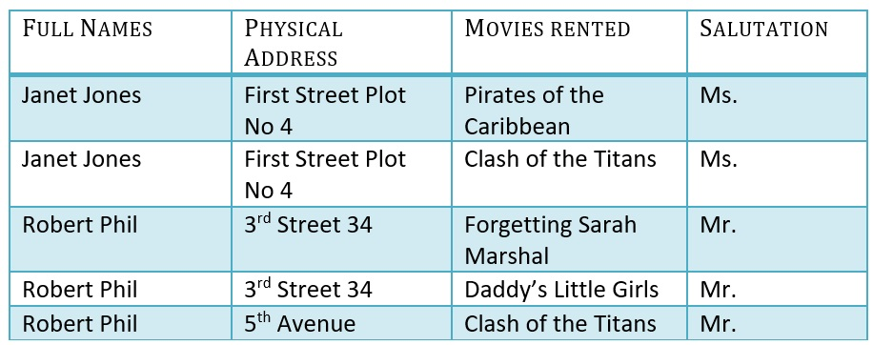
1NF (First Normal Form)
Each table cell should contain a single value
Each record needs to be unique

Slide 22
2NF (Second Normal Form)
Rule 1- Be in 1NF
Rule 2- Single Column Primary Key that does not functionally dependant on any subset of candidate key relation
It is clear that we can’t move forward to make our simple database in 2nd Normalization form unless we partition the table above

Slide 23

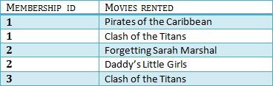
Example
We have divided our 1NF table into two tables viz. Table 1 and Table2. Table 1 contains member information. Table 2 contains information on movies rented.
We have introduced a new column called Membership_id which is the primary key for table 1. Records can be uniquely identified in Table 1 using membership id

Slide 24

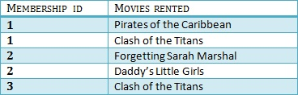

3NF (Third Normal Form)
Rule 1- Be in 2NF
Rule 2- Has no transitive functional dependencies

Slide 25
4NF (Fourth Normal Form)
If no database table instance contains two or more, independent and multivalued data describing the relevant entity, then it is in 4th Normal Form.

Slide 26
5NF (Fifth Normal Form)
A table is in 5th Normal Form only if it is in 4NF and it cannot be decomposed into any number of smaller tables without loss of data.

Slide 27
6NF (Sixth Normal Form)
6th Normal Form is not standardized, yet however, it is being discussed by database experts for some time.

Slide 28


